Slide 1
CMP4221 · MULTIMEDIA SYSTEMS · PAPER PRESENTATION
Encrypt the cube,
not the image.
DWT shrinks the images. A chaotic map encrypts the whole stack as one.
the cube
Multi-Image Encryption Scheme Based on Chaotic Pseudo-Random
Signal Generator and DWT Compression
ACM Transactions on Multimedia · Vol. 22, Issue 3 · 2026
DOI 10.1145/3769123 Yidan Xu · Suo Gao · Yinghong Cao · Jun Mou
Abdul Rahman Malak (2285310) Maria Alftaih (2285921)
Notes:
[~0:30] Good morning. I'm Abdul, this is Maria, and we're presenting a 2026 paper from ACM Transactions on Multimedia by Xu, Gao, Cao and Mou. The whole idea is in our title: instead of encrypting images one at a time, you compress them, stack them into a single 3-D cube, and encrypt that entire cube at once. I'll take the introduction and the novelty — what's new; Maria will take the methodology and the findings — how it works and how well.

Slide 2
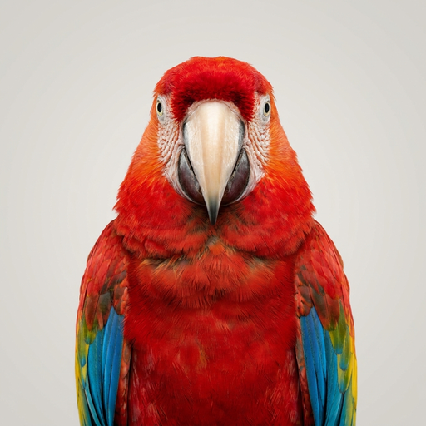


INTRODUCTION · THE BIG PICTURE
02 / 35
In plain English: what does this paper do?
one shared cube
a real image
encrypted = noise
decrypted back
Send a whole batch of images that are smaller AND private at once.
Shrink each image, then scramble them all together into noise.
Only the secret key brings the images back.
CMP4221 · Multimedia Systems | Xu, Gao, Cao & Mou · ACM TOMM, Vol. 22(3), 2026 · DOI 10.1145/3769123
INTRO
Notes:
[~0:35] Before any technical detail, here's the whole paper in plain language. It's a way to send a batch of images that are, at the same time, smaller and private. You take many images, shrink each one, then scramble them all together into what looks like pure static — that middle image is a real encryption of the picture on the left. Anyone who intercepts it just sees noise. The receiver, who has the secret key, unscrambles it and gets the image back, on the right. And they're all packed into one shared cube. That's the entire idea; the rest of the talk is how it's done and how well it works.

Slide 3
INTRODUCTION · THE SOURCE
03 / 35
About the paper.
TITLE
Multi-Image Encryption Scheme Based on Chaotic
Pseudo-Random Signal Generator and DWT Compression
AUTHORS
VENUE
YEAR
DOI
Xu · Gao · Cao · Mou
ACM Trans. on Multimedia
2026 · peer-reviewed
10.1145/3769123
We chose it because the core idea is genuinely new.
The maths stays approachable for a ten-minute talk.
And the results are easy to show visually, as you'll see.
CMP4221 · Multimedia Systems | Xu, Gao, Cao & Mou · ACM TOMM, Vol. 22(3), 2026 · DOI 10.1145/3769123
INTRO
Notes:
[~0:25] A quick word on the source. This is a 2026 paper from ACM Transactions on Multimedia — one of the top peer-reviewed journals in the field — by Xu, Gao, Cao and Mou. The area is image encryption, part of multimedia security. We picked it because the core idea is genuinely new, the maths stays approachable for a ten-minute talk, and the results are easy to show visually.

Slide 4
INTRODUCTION · THE BASICS
04 / 35
First, the basics: what is image encryption?
PLAINTEXT
readable pixels
CIPHERTEXT
looks like noise
PLAINTEXT
restored
encrypt
+ key
decrypt
+ key
Encryption turns readable pixels into noise using a secret key.
Only the same key reverses it.
Two moves: confusion shuffles positions, diffusion changes values.
CMP4221 · Multimedia Systems | Xu, Gao, Cao & Mou · ACM TOMM, Vol. 22(3), 2026 · DOI 10.1145/3769123
INTRO
Notes:
[~0:30] And the one concept everything rests on: encryption. Encryption turns readable data into noise using a secret key, and only the same key turns it back — plaintext to ciphertext and back to plaintext. For an image, the plaintext is just the pixels and the ciphertext looks like television static. Two more words you'll hear a lot: confusion, which means shuffling where the pixels sit, and diffusion, which means changing their values. Hold on to those — plaintext, key, ciphertext, confusion, diffusion — and the rest follows.

Slide 5
INTRODUCTION · THE CHALLENGE
05 / 35
Two goals, normally done separately.
SMALLER
SAFER
Compression
Encryption
shrink each image so a batch is cheap to send
scramble the pixels so the data is private
Normally these are two separate, expensive steps.
Most systems compress first, then encrypt — paying for both.
This paper folds the two into a single pass.
CMP4221 · Multimedia Systems | Xu, Gao, Cao & Mou · ACM TOMM, Vol. 22(3), 2026 · DOI 10.1145/3769123
INTRO
Notes:
[~0:30] It helps to see the two goals side by side, because normally they're handled separately. The first is compression — making each image smaller so a whole batch is cheap to send. The second is encryption — scrambling the pixels so the data stays private. Most systems do one and then the other, paying for two separate pipelines. The clever move in this paper is to fold both into a single pass.

Slide 6
OVERVIEW
06 / 35
What we'll cover in ten minutes.
01
Novelty
Compress every image, stack them, encrypt the whole batch as one cube.
What is genuinely new?
02
Methodology
DWT compression, a chaotic key stream, then confusion and diffusion.
How does it actually work?
03
Findings
32 dB recovered quality and five security tests, all in the ideal range.
Does it actually work?
These are the three things the talk is graded on.
Abdul takes the introduction and the novelty.
Maria takes the methodology and the findings.
CMP4221 · Multimedia Systems | Xu, Gao, Cao & Mou · ACM TOMM, Vol. 22(3), 2026 · DOI 10.1145/3769123
OVERVIEW
Notes:
[~0:25] Here's our plan. We've split the talk into the three things the paper is judged on. First, novelty — what's genuinely new, which is the cube idea. Second, methodology — how the algorithm actually works, step by step. And third, findings — does it work, for both image quality and security. I take the introduction and the novelty; Maria takes the methodology and the results.

Slide 7
CONTEXT · THE PROBLEM
07 / 35
Sending image batches is heavy and exposed.
HEAVY
EXPOSED
786,432 values per image
Raw pixels travel in the clear — anyone on the link can read them.
× N in a batch — scan series, satellite, surveillance.
The usual fix for size is compression.
The usual fix for privacy is encryption.
This paper does both — on the whole batch, in one pass.
CMP4221 · Multimedia Systems | Xu, Gao, Cao & Mou · ACM TOMM, Vol. 22(3), 2026 · DOI 10.1145/3769123
CONTEXT
Notes:
[~0:35] So why does this paper exist? Sending images has two problems at once. They're heavy: a single 512-by-512 colour image is already 786,000 values, and you rarely send just one — think a patient's full scan series, satellite passes, or surveillance feeds. The usual fix is compression. But they're also exposed: raw pixels travel in the clear, so anyone tapping the link can read them, and the usual fix there is encryption. Normally you'd do one or the other, image by image. This paper does both, on the whole batch, in a single pass.

Slide 8
CONTEXT · WHO NEEDS THIS
08 / 35
Where does this actually matter?
Medical
Satellite
Surveillance
Cloud backup
MRI / CT scan series shared between hospitals
large archives of earth-observation imagery
banks of camera feeds stored together
a whole photo library pushed up at once
In every case you send many sensitive images together.
Bandwidth is tight, so you want them small.
They're private, so you want them encrypted.
CMP4221 · Multimedia Systems | Xu, Gao, Cao & Mou · ACM TOMM, Vol. 22(3), 2026 · DOI 10.1145/3769123
CONTEXT
Notes:
[~0:25] To make it concrete, here's who actually needs this. Hospitals sending a patient's MRI or CT scan series between sites. Satellite operators moving huge archives of earth imagery. Surveillance systems storing banks of camera feeds together. Even just backing up a whole photo library to the cloud. In every case you want the images both small and private — which is exactly what this scheme delivers.

Slide 9
1
PART 1 OF 3
Novelty
What is genuinely new in this paper?
Most schemes encrypt one image at a time. This one treats the whole batch as a single object.
CMP4221 · Multimedia Systems | Xu, Gao, Cao & Mou · ACM TOMM, Vol. 22(3), 2026 · DOI 10.1145/3769123
09 / 35
Notes:
[~0:08] So, part one: the novelty. The single question here is — what is genuinely new in this paper compared to ordinary image encryption?

Slide 10
NOVELTY · THE BUILDING BLOCK
10 / 35
An image is just a grid of numbers.
182
176
160
120
88
190
184
150
96
70
201
188
130
80
64
176
150
110
92
78
120
96
84
100
130
our test image
pixel values · 0–255
A digital image is just a grid of numbers — one per pixel.
Each value is a brightness from 0 to 255.
So compressing or encrypting is really maths on a grid.
CMP4221 · Multimedia Systems | Xu, Gao, Cao & Mou · ACM TOMM, Vol. 22(3), 2026 · DOI 10.1145/3769123
NOVELTY
Notes:
[~0:25] A quick foundation, because everything rests on it. A digital image is nothing more than a grid of numbers — each pixel is a value from 0 to 255 for how bright it is. On the left is our test image; zoom in far enough and it really is just this grid of numbers on the right. So when we say we 'compress' or 'encrypt' an image, we actually mean doing arithmetic on a big grid of numbers. Hold on to that picture.

Slide 11
NOVELTY · THE BUILDING BLOCK
11 / 35
Stack the images into a 3-D cube.
stack
(i, j, k)
row · column ·
which image
one image = 2-D grid
a batch = 3-D cube
One image is a 2-D grid; a batch is a stack of grids.
Stacked together they form one 3-D block — the cube.
A pixel now needs three coordinates: (i, j, k).
CMP4221 · Multimedia Systems | Xu, Gao, Cao & Mou · ACM TOMM, Vol. 22(3), 2026 · DOI 10.1145/3769123
NOVELTY
Notes:
[~0:25] And here's the leap that makes the whole paper work. One image is a flat, 2-D grid. But put many images on top of each other and you get a 3-D block — a cube. The key consequence is on the right: to point at a single pixel you now need three coordinates — i, j and k: the row, the column, and which image it came from. That third coordinate, the depth, is exactly what lets one key reach across every image at once.

Slide 12
NOVELTY · THE CONTRAST
12 / 35
The old way: one image, one pipeline.
#1
IMAGE
COMPRESS
ENCRYPT
SEND
COST PER BATCH
2N
#2
IMAGE
COMPRESS
ENCRYPT
SEND
processing steps
#3
IMAGE
COMPRESS
ENCRYPT
SEND
N keys
… repeat for every single image
Each image gets its own pipeline: compress, encrypt, send.
N images → about 2N processing steps and N separate keys.
It works, but it does not scale to large batches.
CMP4221 · Multimedia Systems | Xu, Gao, Cao & Mou · ACM TOMM, Vol. 22(3), 2026 · DOI 10.1145/3769123
NOVELTY
Notes:
[~0:30] Here's the standard approach this paper improves on. For each image you run a full pipeline — compress it, encrypt it, send it — and then you repeat that for the next image, and the next. So for a batch of N images you pay about 2N processing steps and you manage N separate keys. It works, but the cost grows with every image, and for large batches it just doesn't scale. That's the gap the paper targets.

Slide 13
NOVELTY · THE IDEA
13 / 35
Encrypt the whole batch as one cube.
DWT
stack
encrypt ×1
COST PER BATCH
~3 steps · 1 key
N images
LL bands
Cube C
Cipher D
Compress every image with DWT, keep only the LL part.
Stack all the parts into one 3-D cube, C.
Encrypt the whole cube once — about 3 steps, one key.
CMP4221 · Multimedia Systems | Xu, Gao, Cao & Mou · ACM TOMM, Vol. 22(3), 2026 · DOI 10.1145/3769123
NOVELTY
Notes:
[~0:40] And this is the novelty — the title of our talk. Instead of per-image pipelines, you compress every image with DWT and keep only the lightweight LL part. You stack all those compressed parts into one three-dimensional cube, called C. Then you encrypt that whole cube one time — roughly three steps and a single key, no matter how many images are in it. So the cost stops scaling with the number of images. There is one honest limitation we'll come back to in the findings: if the images are different sizes, the cube has to be zero-padded.

Slide 14
NOVELTY · THE BONUS PROPERTY
14 / 35
One cube means every image is entangled.
flip 1 pixel
one batch, one cipher
all layers change
All images share one cipher, so they are linked together.
Flip one pixel in any image → every image's ciphertext changes.
So an attacker can't isolate or attack a single image.
CMP4221 · Multimedia Systems | Xu, Gao, Cao & Mou · ACM TOMM, Vol. 22(3), 2026 · DOI 10.1145/3769123
NOVELTY
Notes:
[~0:30] Stacking everything into one cube has a powerful side-effect: the images become cryptographically entangled. Because they all share a single cipher, they're linked together. If an attacker flips even one pixel in any one image, the ciphertext of every image in the batch changes. That means they can't peel off and attack a single image on its own — they have to face the whole cube. That entanglement is a big part of what makes the scheme hard to break.

Slide 15
NOVELTY · THE RECIPE
15 / 35
The recipe: two ingredients.
DWT
Chaos
shrink
scramble
compress each image down to its essential part
generate the key stream that hides the cube
Together they are the whole method: shrink, then scramble.
Both are driven by the secret key, so both reverse cleanly.
Maria now shows exactly how each one works.
CMP4221 · Multimedia Systems | Xu, Gao, Cao & Mou · ACM TOMM, Vol. 22(3), 2026 · DOI 10.1145/3769123
NOVELTY
Notes:
[~0:25] So the whole scheme is built from just two ingredients. First, the DWT — a wavelet transform that shrinks each image down to its essential part. Second, a chaotic map — which generates the key stream that scrambles the cube. Shrink, then stack, then scramble. Those two tools are the rest of the talk, so I'll hand over to Maria to show exactly how each one works. Over to you, Maria.

Slide 16
2
PART 2 OF 3
Methodology
How does the algorithm actually work?
Two ingredients — DWT and a chaotic map — combine through a four-stage pipeline.
CMP4221 · Multimedia Systems | Xu, Gao, Cao & Mou · ACM TOMM, Vol. 22(3), 2026 · DOI 10.1145/3769123
16 / 35
Notes:
[~0:08] Thanks, Abdul. Part two — the methodology: how the algorithm actually works. The whole thing is built from two ingredients, DWT and a chaotic map, combined through a four-stage pipeline. Let me walk it.

Slide 17
METHODOLOGY · THE PIPELINE
17 / 35
Four stages, one key, one cube out.
01
02
03
04
DWT
Stack
Confuse
Diffuse
keep the LL band
build the cube C
move the pixels
XOR the values
Eq. 4
Eq. 5–6
Eq. 8–10
Eq. 11–13
Stages 1–2 prepare the data; stages 3–4 are the encryption.
The output is the cipher cube D.
To decrypt, use the same key and reverse every stage.
CMP4221 · Multimedia Systems | Xu, Gao, Cao & Mou · ACM TOMM, Vol. 22(3), 2026 · DOI 10.1145/3769123
METHODOLOGY
Notes:
[~0:30] So how does it actually work? The pipeline is four stages. Stage one, DWT, compresses each image by keeping the LL band — that's Equation 4. Stage two stacks those bands into the cube C — Equations 5 and 6. Stage three, confusion, moves the pixels around — Equations 8 to 10. Stage four, diffusion, changes the pixel values with XOR — Equations 11 to 13. The first two stages prepare the data; the last two are the actual encryption. The output is the cipher cube D, and to decrypt you simply use the same key and run every stage backwards.

Slide 18
METHODOLOGY · VOCABULARY
18 / 35
Five words you'll hear throughout.
Plaintext
the original image data we want to protect
Ciphertext
the scrambled, noise-like output sent over the link
Key
the secret numbers that drive — and reverse — encryption
Confusion
rearranging where pixels sit (positions change)
Diffusion
changing what pixels are worth (values change)
Keep these five straight and the rest of the talk follows.
The two to watch: confusion (positions) versus diffusion (values).
CMP4221 · Multimedia Systems | Xu, Gao, Cao & Mou · ACM TOMM, Vol. 22(3), 2026 · DOI 10.1145/3769123
METHODOLOGY
Notes:
[~0:20] Five quick words you'll hear throughout. Plaintext is the original image data we're protecting. Ciphertext is the scrambled, noise-like output that goes over the link. The key is the secret set of numbers that drives encryption and is the only thing that reverses it. And the two halves of the encryption: confusion means rearranging where pixels sit, and diffusion means changing what the pixels are worth. Confusion moves, diffusion changes.

Slide 19
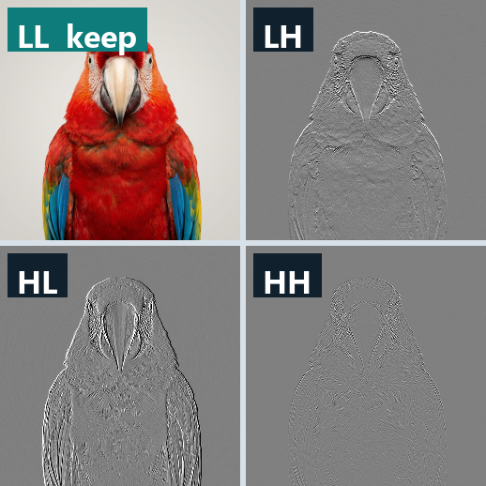
METHODOLOGY · TOOL 1 — DWT
19 / 35
One transform splits an image into four.
LL the rough visual base — half size — KEEP it
LH horizontal edge detail — drop
HL vertical edge detail — drop
HH diagonal edge detail — drop
DWT is the wavelet cousin of the DCT used in JPEG.
It separates the rough base from the fine edge detail.
We keep the base because vision lives in low frequencies.
CMP4221 · Multimedia Systems | Xu, Gao, Cao & Mou · ACM TOMM, Vol. 22(3), 2026 · DOI 10.1145/3769123
METHODOLOGY
Notes:
[~0:35] The first ingredient is the Discrete Wavelet Transform, the wavelet cousin of the DCT used in JPEG. One pass splits an image into four sub-bands, each at half the width and half the height. What you're looking at is a real Haar decomposition of our test image. The top-left, LL, is the rough visual base — you can still recognise the bird — and that's the one the scheme keeps. The other three — LH, HL and HH — hold the horizontal, vertical and diagonal edge detail, and those get thrown away.

Slide 20

METHODOLOGY · TOOL 1 — DWT
20 / 35
Keep LL. Drop three-quarters.
¼ the area
single-level DWT · Eq. 4
LL · 256²
ORIGINAL · 512²
Keeping only LL drops 75% of the pixels.
Vision lives in low frequencies, so the eye barely notices.
Lossy, but the recovery still looks right.
CMP4221 · Multimedia Systems | Xu, Gao, Cao & Mou · ACM TOMM, Vol. 22(3), 2026 · DOI 10.1145/3769123
METHODOLOGY
Notes:
[~0:30] Keeping only LL means each image shrinks to a quarter of its area — 75% of the pixels are gone. We get away with that because human vision lives in the low frequencies: the eye barely notices the missing edge detail. On the left is the original, on the right the LL band at a quarter of the size. It's lossy, but as you'll see, the recovered image still looks right. This is single-level DWT — Equation 4.

Slide 21
METHODOLOGY · TOOL 2 — CHAOS
21 / 35
A chaotic map is deterministic randomness.
Key A x0 = 0.5000
Key B x0 = 0.5000 + 10⁻¹⁵
THE KEY = 9 NUMBERS
a b c d e f
x0 y0 z0
+ a 125,000-step burn-in,
tied to the image data
The output looks random but is fully repeatable from its start.
Change one bit of the key → a completely different stream.
A 125,000-step burn-in makes it pass randomness tests.
CMP4221 · Multimedia Systems | Xu, Gao, Cao & Mou · ACM TOMM, Vol. 22(3), 2026 · DOI 10.1145/3769123
METHODOLOGY
Notes:
[~0:35] The second ingredient is a 3-D chaotic map. You iterate it and it produces a stream that looks completely random but is fully deterministic — same starting numbers, same stream every time. The key is nine secret numbers: six system parameters, a through f, plus three seeds, x-zero, y-zero and z-zero. The two curves show the crucial property: two keys that differ by just 10-to-the-minus-15 track together for a moment, then diverge completely. There's also a 125,000-iteration warm-up, and the key is tied to the image data itself.

Slide 22
METHODOLOGY · BUILDING THE CUBE
22 / 35
Stack the LL bands into the plaintext cube C.
Cube C
(h_max⁄2) × (w_max⁄2) × depth
Eq. 5–6
one layer per image channel
Each image's LL band becomes one layer of the cube.
Smaller images are zero-padded to fit.
Six numbers from the cube fold into the key, so it depends on the images.
CMP4221 · Multimedia Systems | Xu, Gao, Cao & Mou · ACM TOMM, Vol. 22(3), 2026 · DOI 10.1145/3769123
METHODOLOGY
Notes:
[~0:25] First we build the plaintext cube. Every image's LL band becomes one layer of the cube, and the cube's size is half the tallest height by half the widest width, by however many layers we need — Equations 5 and 6. If images are different sizes, the smaller bands are padded with zeros to fit. One clever detail: six numbers computed from the cube are folded into the key, in Equation 7 — so the key actually depends on the images themselves, which blocks a whole class of attacks.

Slide 23
METHODOLOGY · CONFUSION
23 / 35
Confusion: move positions, keep values.
E
N
C
R
Y
P
T
VALUES
unchanged
shuffle positions
POSITIONS
T
Y
R
E
P
N
C
scrambled
Confusion = move positions, keep the values.
Like shuffling Scrabble tiles: same letters, nonsense board.
Shannon's first requirement for a strong cipher.
CMP4221 · Multimedia Systems | Xu, Gao, Cao & Mou · ACM TOMM, Vol. 22(3), 2026 · DOI 10.1145/3769123
METHODOLOGY
Notes:
[~0:25] The encryption has two halves. The first is confusion: move the positions, keep the values. Up top the tiles spell ENCRYPT; after confusion the very same tiles are shuffled into nonsense. Nothing about the values changed — only where they sit. This is Shannon's first requirement for a strong cipher, and the easiest way to picture it is shuffling Scrabble tiles: same letters, unreadable board.

Slide 24
METHODOLOGY · CONFUSION
24 / 35
How confusion chooses each move.
before
after
B
3 offsets → 9 swap cases
A
C
S1, T1, U1 · one per axis · Eq. 8–10
B
A
C
The chaotic map decides every swap, so it's fully key-driven.
Only the same key can walk the swaps backwards.
Pixel values are never touched — this stage only moves them.
CMP4221 · Multimedia Systems | Xu, Gao, Cao & Mou · ACM TOMM, Vol. 22(3), 2026 · DOI 10.1145/3769123
METHODOLOGY
Notes:
[~0:30] Mechanically, here's how confusion decides each move. You iterate the chaotic map once per pixel and quantise it into three offset sequences — S1, T1, U1 — one for each axis of the cube, Equations 8 and 9. For every pixel, its coordinates i, j, k are compared against those offsets, and that picks one of nine possible swap cases — Equation 10. Run it for every pixel and you get the confusion cube C-prime: exactly the same pixel values, completely scrambled positions, as the before-and-after grids show.

Slide 25
METHODOLOGY · DIFFUSION
25 / 35
Diffusion: change values, keep positions.
41
7F
08
C3
92
POSITIONS
unchanged
XOR with chaos
VALUES
D6
1A
BB
57
2E
flipped (separate stream)
Diffusion = change values, keep positions.
Each value is XORed with a byte from a separate chaos stream.
Separate stream — reusing confusion's would leak structure.
CMP4221 · Multimedia Systems | Xu, Gao, Cao & Mou · ACM TOMM, Vol. 22(3), 2026 · DOI 10.1145/3769123
METHODOLOGY
Notes:
[~0:25] The second half is diffusion: keep the positions, change the values. Each pixel value is XORed with a byte from a separate chaos stream — X2, Y2, Z2. It has to be a separate stream: if we reused the confusion sequence, the redundancy could leak structure to an attacker. So the positions are now frozen, but every value has flipped.

Slide 26
METHODOLOGY · DIFFUSION
26 / 35
The diffusion equation.
D[k] = V[k] ⊕ chaos[k mod 3] ⊕ D[k-1]
V[k]
chaos[k mod 3]
D[k-1]
value from confusion
a byte from the chaos stream
previous cipher byte = the chain
Cipher byte = confused value XOR chaos byte XOR the previous byte.
That last term chains outputs — like CBC mode at the pixel level.
XOR is its own inverse, so the same key undoes it.
CMP4221 · Multimedia Systems | Xu, Gao, Cao & Mou · ACM TOMM, Vol. 22(3), 2026 · DOI 10.1145/3769123
METHODOLOGY
Notes:
[~0:30] Here's the actual diffusion equation. The cipher byte D-k equals the confused value V-k, XORed with a chaos byte chosen by k-mod-3, XORed with the previous cipher byte, D-k-minus-1. That last term is the key idea: every output is chained to the one before it — it's essentially CBC mode at the pixel level, Equations 12 and 13. And because XOR is its own inverse, the same key undoes the entire thing on the receiver's side.

Slide 27
METHODOLOGY · DIFFUSION
27 / 35
One flipped bit cascades through everything.
D[0]
D[1]
D[2]
D[3]
D[4]
D[5]
D[6]
D[7]
flip
changed
changed
changed
changed
changed
changed
changed
Each byte depends on the one before it.
Flip one bit at the start → every later byte changes.
That cascade is why NPCR ≈ 99.65%.
CMP4221 · Multimedia Systems | Xu, Gao, Cao & Mou · ACM TOMM, Vol. 22(3), 2026 · DOI 10.1145/3769123
METHODOLOGY
Notes:
[~0:25] That chain creates the avalanche effect. Since each byte depends on the byte before it, flipping a single bit at the very start — D-zero here — cascades and changes every byte after it. This is the mechanism behind the headline security number: it's exactly why NPCR, the differential metric, sits at about 99.65% — one changed input pixel scrambles essentially the entire ciphertext.

Slide 28
3
PART 3 OF 3
Findings
Does it actually work?
Near-lossless recovery, and five standard security tests that all land in the ideal range.
CMP4221 · Multimedia Systems | Xu, Gao, Cao & Mou · ACM TOMM, Vol. 22(3), 2026 · DOI 10.1145/3769123
28 / 35
Notes:
[~0:08] Part three: the findings — does it actually work? Two things to prove: that the recovered images are good quality, and that the cipher is genuinely secure.

Slide 29
FINDINGS · REVERSIBILITY
29 / 35
Encrypt to noise, decrypt back.
encrypt
decrypt
original
cipher cube D — noise
recovered
Encrypt the cube → it becomes pure noise.
Decrypt with the key and inverse-DWT → the image returns.
Our Haar demo recovers at 32.16 dB ≈ the paper's 32.06 dB.
CMP4221 · Multimedia Systems | Xu, Gao, Cao & Mou · ACM TOMM, Vol. 22(3), 2026 · DOI 10.1145/3769123
FINDINGS
Notes:
[~0:30] So, does it work? First, reversibility. We encrypt the compressed cube and it turns into pure noise — that middle image is a genuine cipher of our test picture. Decrypt with the correct key and inverse-DWT, and the image comes back. We actually reproduced the whole pipeline ourselves: a one-level Haar round trip recovered at 32.16 decibels — which lines up almost exactly with the paper's reported 32.06.

Slide 30
FINDINGS · IMAGE QUALITY
30 / 35
Recovered quality: 32.06 dB.
Average PSNR over 12 test images
32.06 dB
RULE OF THUMB
above 30 dB
= visually identical to the original.
Average PSNR is 32.06 dB over 12 images.
That's after compression AND a full encrypt-decrypt cycle.
Above 30 dB = visually identical to the original.
CMP4221 · Multimedia Systems | Xu, Gao, Cao & Mou · ACM TOMM, Vol. 22(3), 2026 · DOI 10.1145/3769123
FINDINGS
Notes:
[~0:25] That's the headline quality number: an average PSNR of 32.06 decibels across twelve test images — and that's after both lossy compression and a full encrypt-then-decrypt cycle. The rule of thumb is that anything above 30 decibels is visually identical to the original. So even though we threw away three-quarters of every image and then encrypted it, what comes back looks the same to a human eye.

Slide 31
FINDINGS · VS PRIOR WORK
31 / 35
Above the line; prior work below it.
30 dB threshold
This paper
32.06 dB
Ref. 22
27.69 dB
Ref. 19
27.49 dB
Ref. 46
27.34 dB
Ref. 8
26.29 dB
Prior chaos-based schemes sit at 26–28 dB; this one reaches 32.06.
PSNR is logarithmic — a 4–6 dB gap ≈ 2.5–4× less error.
CMP4221 · Multimedia Systems | Xu, Gao, Cao & Mou · ACM TOMM, Vol. 22(3), 2026 · DOI 10.1145/3769123
FINDINGS
Notes:
[~0:28] And it's not just good in isolation — it beats prior work. Four earlier chaos-based schemes all land between 26 and 28 decibels, below the 30-decibel line. This paper crosses it at 32.06. And because PSNR is a logarithmic scale, that four-to-six-decibel gap actually means roughly two-and-a-half to four times less reconstruction error. So it's a meaningful jump, not a rounding difference.

Slide 32
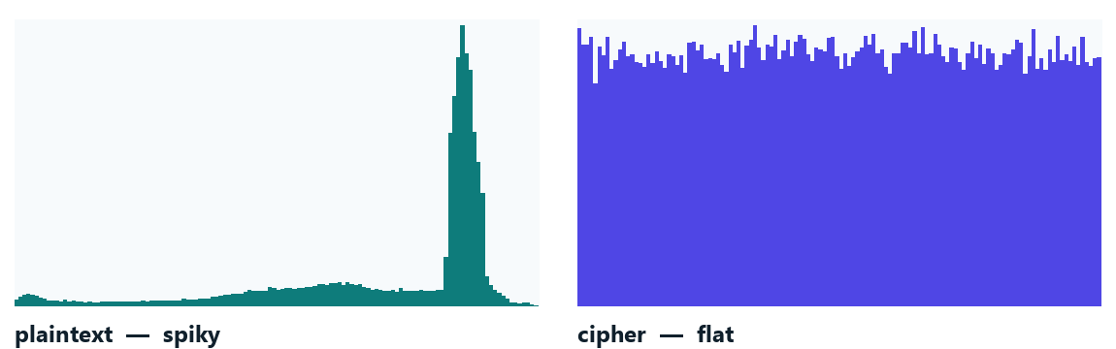
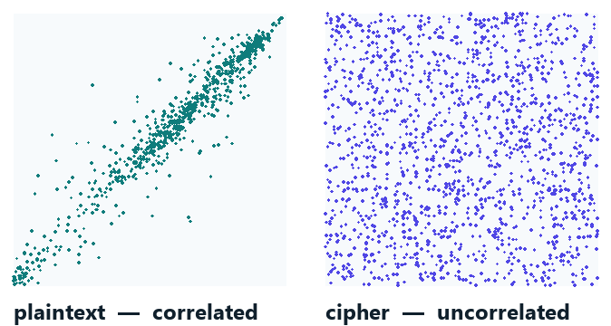
FINDINGS · STATISTICAL SECURITY
32 / 35
The cipher behaves like pure noise.
Histogram goes spiky → flat, so frequency analysis fails.
Adjacent-pixel correlation collapses to a random cloud.
CMP4221 · Multimedia Systems | Xu, Gao, Cao & Mou · ACM TOMM, Vol. 22(3), 2026 · DOI 10.1145/3769123
FINDINGS
Notes:
[~0:30] Two classic statistical tests, and both panels here are computed on our own cipher. On the left, the histogram: the plaintext is spiky — some pixel values are far more common than others — but the cipher is flat, every value equally likely, so frequency analysis tells an attacker nothing. On the right, adjacent-pixel correlation: in the plaintext, neighbouring pixels are tightly correlated, forming a diagonal line; in the cipher, that collapses into a random cloud. These are the same two tests the paper runs in its Figures 12 and 14.

Slide 33
FINDINGS · SECURITY SCORECARD
33 / 35
Five standard tests — all in the ideal zone.
ACHIEVED
TARGET
NIST suite
15 / 15 pass
p ≥ 0.01
NPCR
99.6533%
99.6094%
UACI
33.4887%
33.4635%
Entropy
7.9994 / 8
8.0000
Key space
≈ 2⁴⁴⁸
> 2¹⁰⁰
Every test lands at or beyond its ideal target.
Honest caveat: strong statistical evidence — not a formal proof like AES.
CMP4221 · Multimedia Systems | Xu, Gao, Cao & Mou · ACM TOMM, Vol. 22(3), 2026 · DOI 10.1145/3769123
FINDINGS
Notes:
[~0:35] Here's the full security scorecard — five standard tests, and every one lands in the ideal zone. The NIST randomness suite: all 15 tests passed. NPCR is 99.65% and UACI is 33.49%, both essentially on the ideal targets. Entropy is 7.9994 out of a maximum of 8 — basically a perfectly uniform histogram. And the key space is about 2-to-the-448, far beyond the 2-to-the-100 brute-force threshold. One honest note, which earns us credit rather than costing it: these are strong statistical results, not a formal mathematical proof the way AES has.

Slide 34
FINDINGS · THE HONEST LIMIT
34 / 35
The cost: zero-padding and a slow chain.
Two honest costs
wasted padding
Different sizes → zero-padding that's still encrypted and sent.
~6 MB/s vs ~500 for AES — the diffusion chain is serial.
Authors flag the padding as future work.
CMP4221 · Multimedia Systems | Xu, Gao, Cao & Mou · ACM TOMM, Vol. 22(3), 2026 · DOI 10.1145/3769123
FINDINGS
Notes:
[~0:25] We should be honest about the costs. Because images can be different sizes, the cube has to fit the largest one, so smaller images get padded with zeros — and that padding is still encrypted and transmitted, which wastes work and bandwidth. The authors flag fixing that as future work. There's also a speed cost: throughput is around 6 megabytes per second, versus hundreds for AES, because the diffusion chain is serial — each pixel waits for the one before it, so it can't be parallelised.

Slide 35
WRAP-UP
35 / 35
One pipeline: shrink, stack, scramble.
DWT
Chaos
Cube
handles size
handles secrecy
handles batches
Compression and encryption · multiple images · one pass.
Questions?
Thank you.
CMP4221 · Multimedia Systems | Xu, Gao, Cao & Mou · ACM TOMM, Vol. 22(3), 2026 · DOI 10.1145/3769123
WRAP-UP
Notes:
[~0:25] So to wrap up: DWT handles the size problem, the chaotic map handles secrecy, and the cube handles doing it all on a whole batch at once — compression and encryption, multiple images, in a single pass. If you remember three words from this talk, make them: shrink, stack, scramble. Thank you — we're happy to take any questions.

